Slide 1
Digital Media Technology Week 2: XML Basics

Slide 2
<html>
<head>
<title>
Title of the website
</title>
</head>
<body>
<p> This is a paragraph
<b>This text is shown in bold</b>
</p>
</body>
</html>

Slide 3
<table>
<tr>
<td>
Row 1 , Cell 1
</td>
</tr>
<tr>
<td>
Row 2 , Cell 1
</td>
</tr>
</table>

Slide 4
CSS
A selector combined with formatting instructions
internal or external stylesheets
Example:
body { background-color: #d0e4fe; } p { font-family: "Times New Roman” ; }

Slide 5
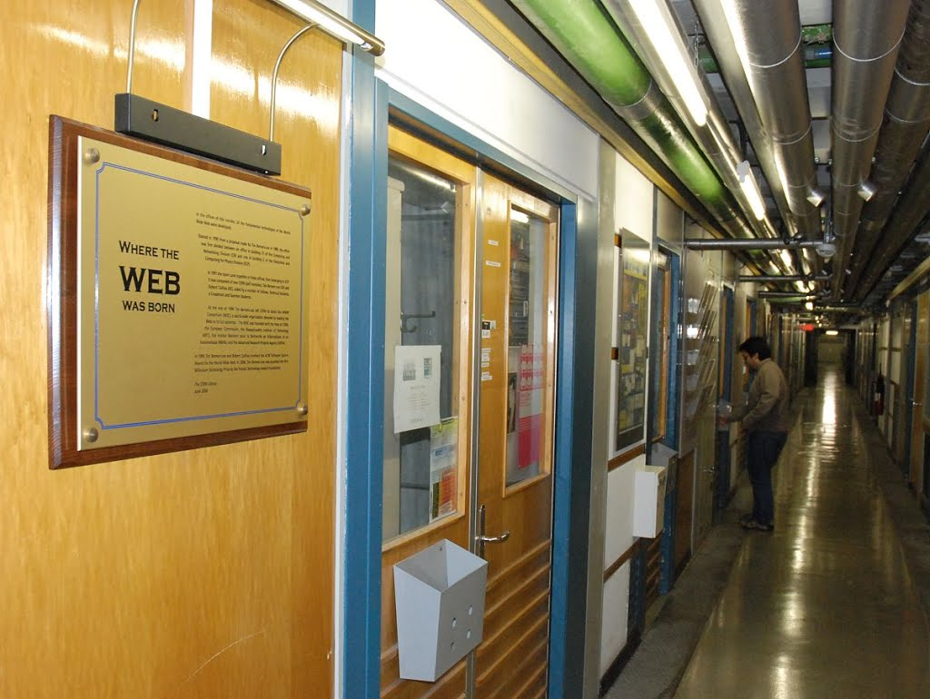
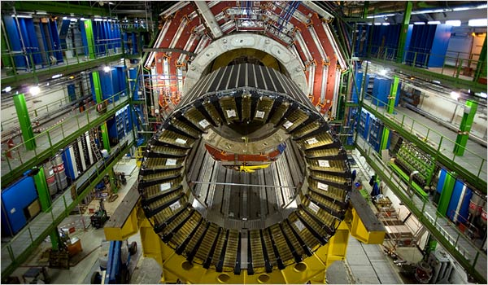
HTML
Developed at CERN by Tim Berners-Lee; first proposal: March 1989

Slide 6
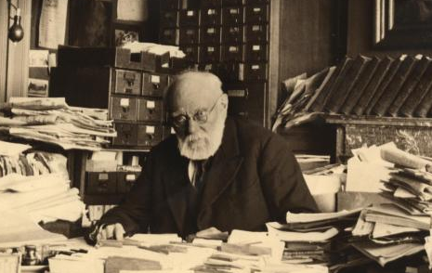
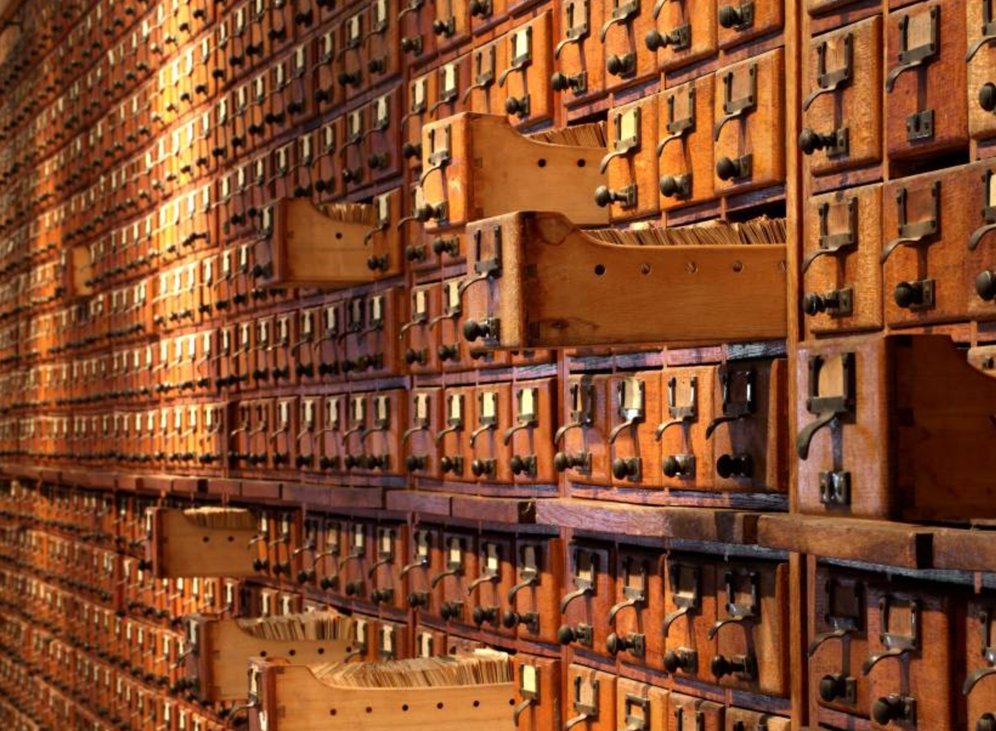
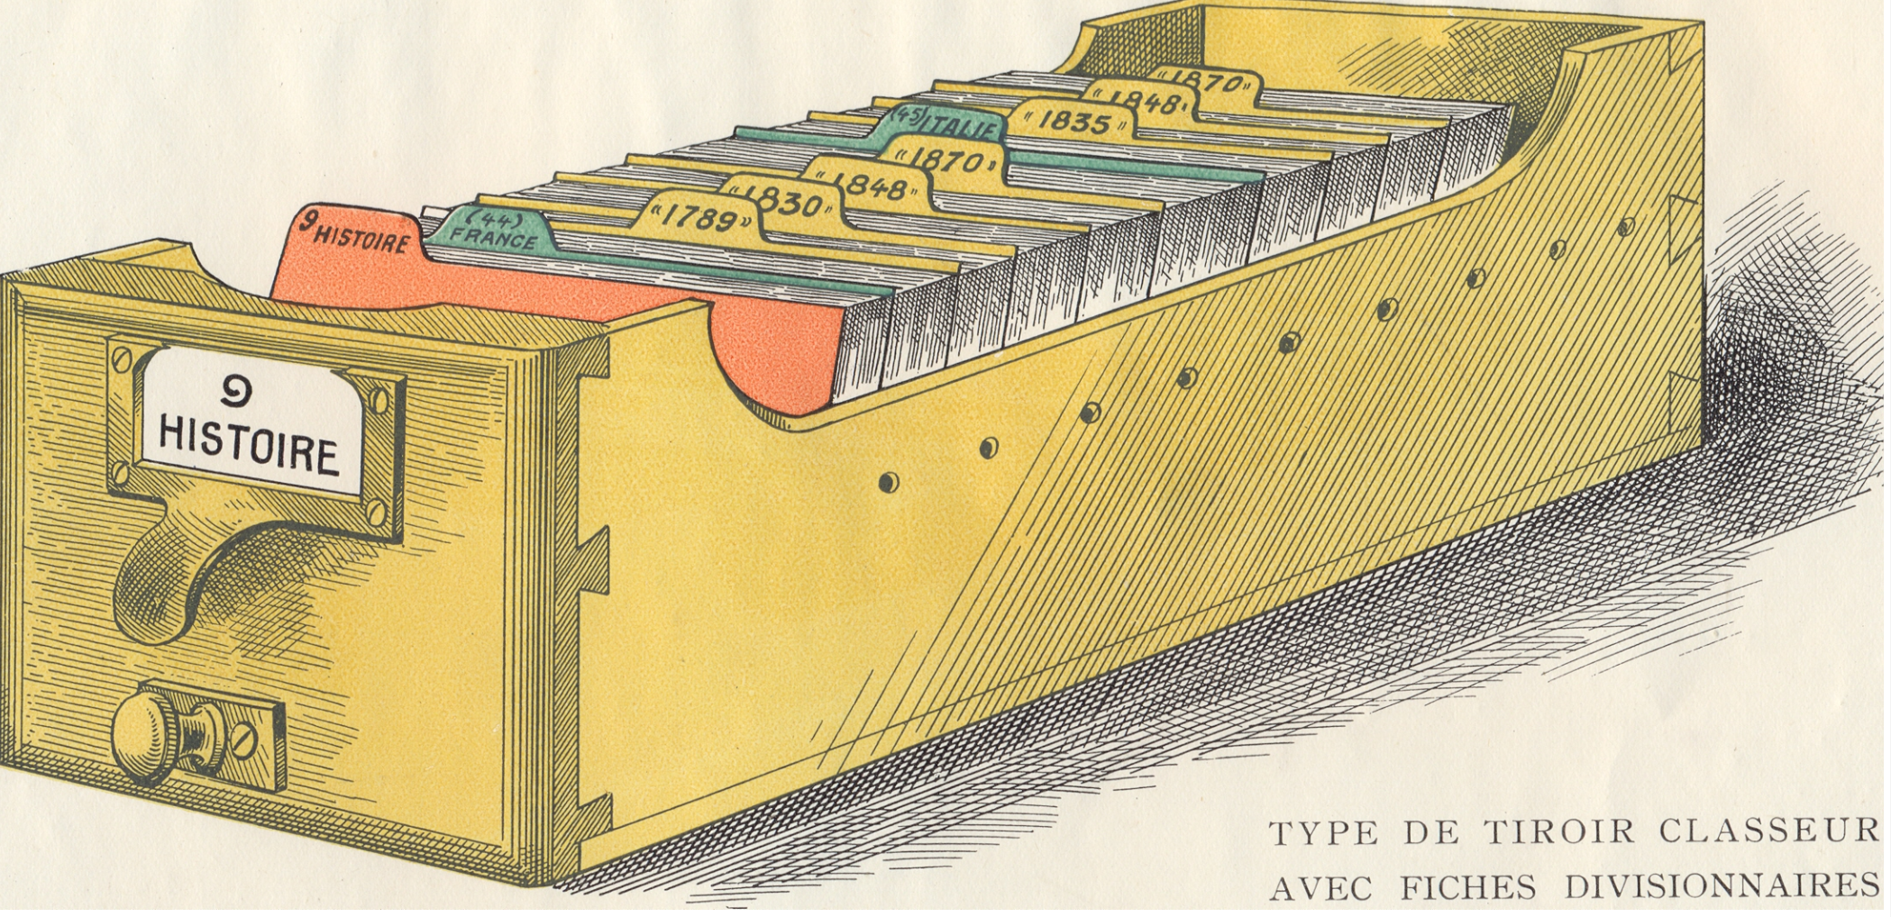
Otlet’s Mundaneum

Slide 7
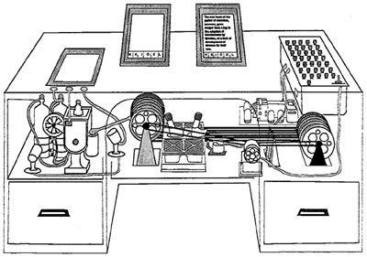
Bush’s Memex
“associative indexing, the basic idea of which is a provision whereby any item may be caused at will to select immediately and automatically another”
From As We May Think

Slide 8
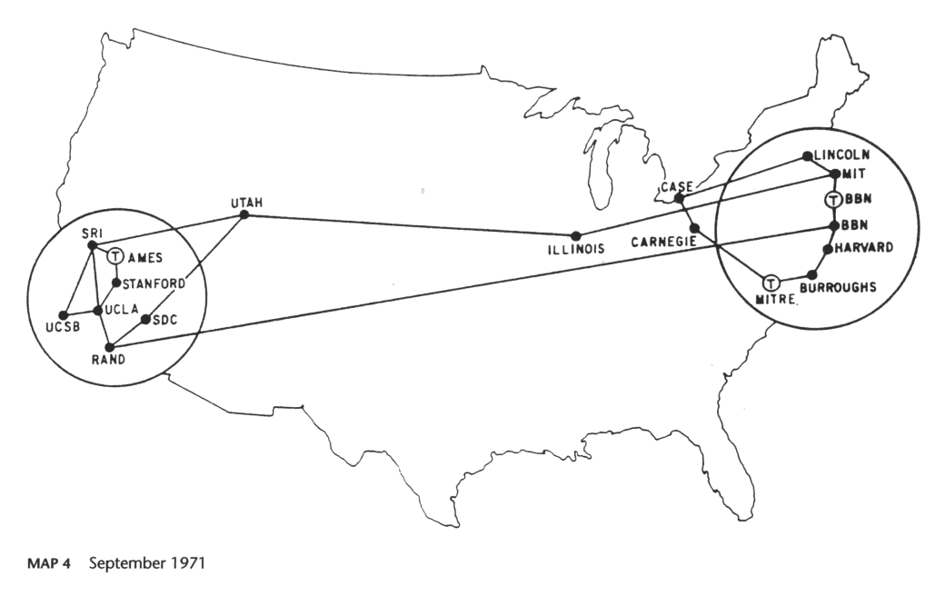
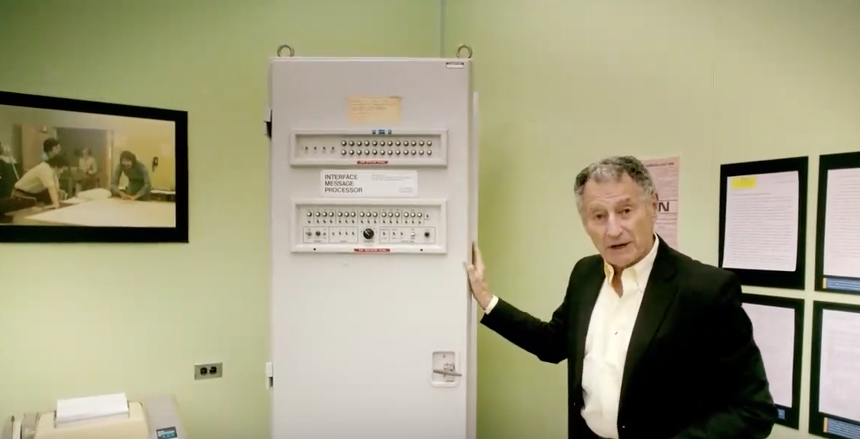
ARPANet and Internet

Slide 9
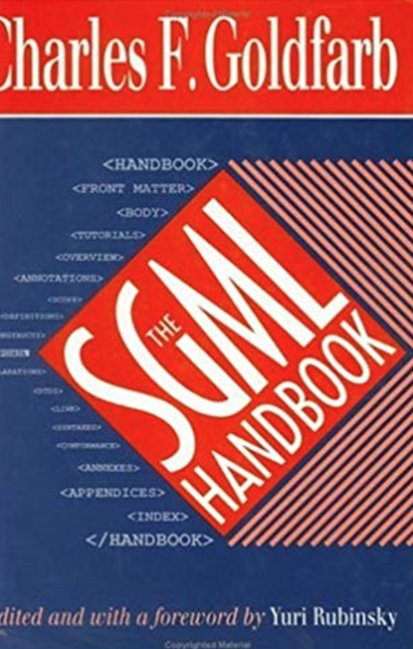
SGML
Standard Generalised Markup Language
Developed in 1960s by Charles Goldfarb, Edward Mosher, and Raymond Lorie
Focus on declarative markup

Slide 10
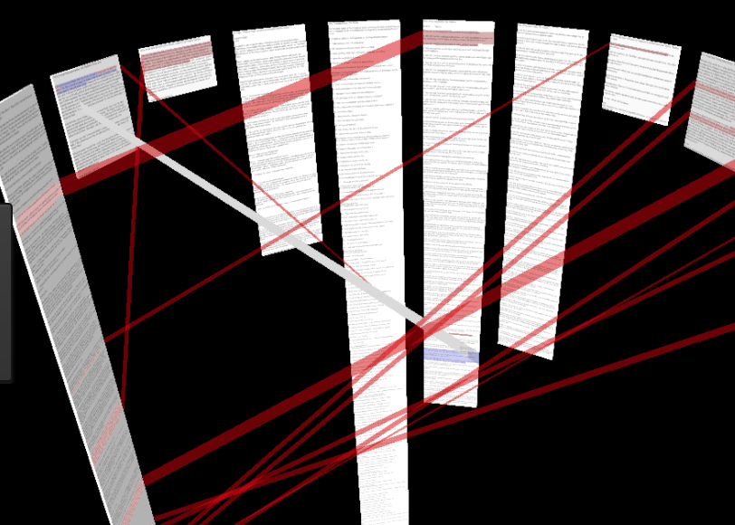
Nelson’s concept op hypertext
Often cited as the author who coined the term ‘hypertext’ in 1963
Monograph Literary Machines
Developed the application Xanadu, based on SGML

Slide 11
Text encoding and hypertext
Documents which contain hyperlinks
Hypertexts are based on encoding systems which can identify the fragments which ought to serve as links
More generally: based on a system which prescribes the type of units that can occur within a text
Hypertexts follow specific syntactic rules

Slide 12

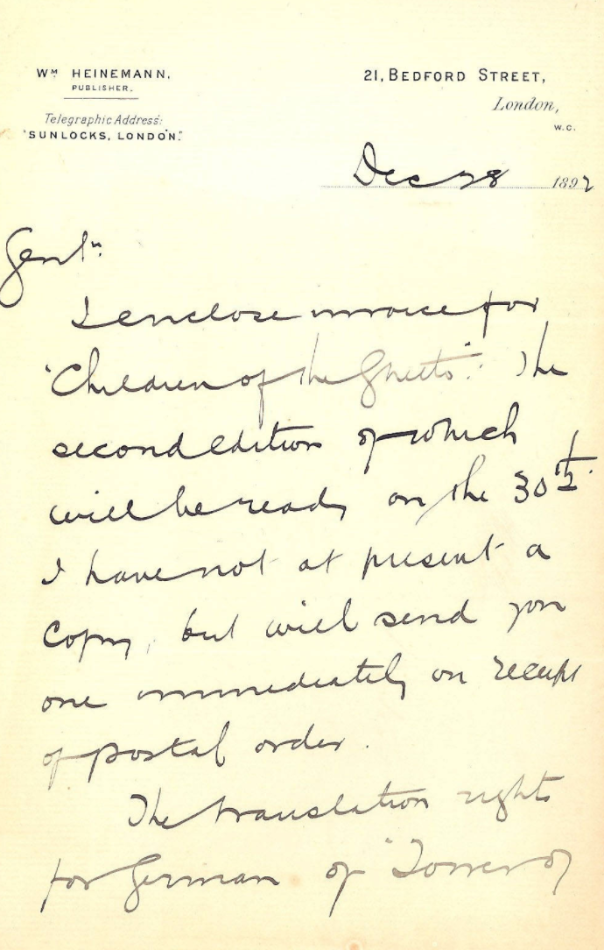
Booktrade Correspondence Project
Application of text encoding
Study of correspondence from the Dutch book trade in the 19c
Primary materials:
Archive of De Erven F. Bohn
Archive of A.W. Sijthoff

Slide 13
Research questions
Social network of publishing houses
Which book titles are mentioned in the correspondence?
How international was the Dutch Booktrade in the 19C?
Who were Bohn’s and Sijthoff’s competitors?

Slide 14
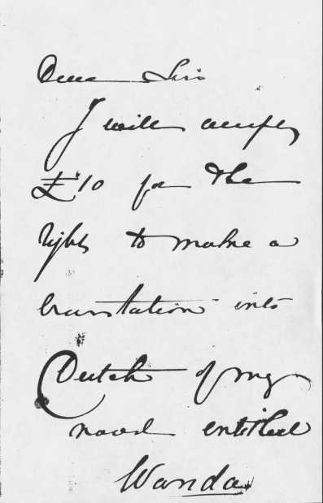
Dear Sirs,
I will accept /
£10 for the /
rights to make a /
translation into /
Dutch of my /
novel entitled /
Wanda //

Slide 15
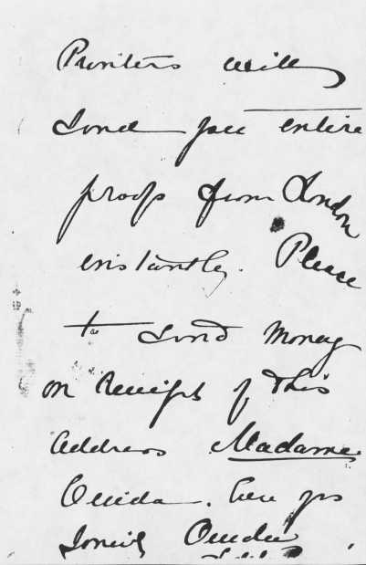
Printers will /
send you entire /
proofs from London /
instantly. Please /
to send money /
on receipt of this /
Address Madame /
Ouida. ~c. 2 words illegible~/
~c. 1 word illegible~ Ouida /
L. de la Ramée

Slide 16
Example of a transcription
Gentlemen,
I reply to your letter of the 29th Ulto, offering 30 £ for an early copy of my late father's forthcoming novel Kenelm Chellengly. I beg to inform you that I have simultaneously received from another Dutch Firm, precisely the same offer, viz. 30 £ for an early copy of that work, with a view to a Dutch translation of it (…). Your obedt. Servt,
Lytton Knebworth Park Stevenage Herts

Slide 17
Encoded text
Gentlemen,
I reply to your letter of the <date>29th Ulto</date>, offering 30 £ for an early copy of my late father's forthcoming novel <title>Kenelm Chellengly</title>. I beg to inform you that I have simultaneously received from another Dutch Firm, precisely the same offer, viz. 30 £ for an early copy of that work, with a view to a Dutch translation of it (…). Your obedt. Servt,
<persName>Lytton</persName> Knebworth Park <placeName>Stevenage</placeName> Herts

Slide 18
eXtensible Markup Language
A system that can be used to make statements about text fragments
Use of elements, e.g. p, b, i, or title, persName, date
Makes use of opening and closing tags, e.g. <p> and </p>

Slide 19
XML elements situate and describe text fragments
Example:
<persName>James Joyce</persName>’s novel <title>Ullyses</title> was first published in <date>1922</date>.

Slide 20
Attributes
<name type= “person”>A.W. Sijthoff</name>
Property
Value
your letter of the <date value=“1873-10-29”>29th Ulto</date>

Slide 21
Document type definition
<!ELEMENT literatureList ( item)*>
<!ELEMENT author (#PCDATA)>
<!ELEMENT title (#PCDATA)>
<!ELEMENT edition (#PCDATA)>
<!ELEMENT physicalDescription ( extent | dimensions)*>
<!ELEMENT date (#PCDATA)>
<!ELEMENT publisher (#PCDATA)>
<!ELEMENT imprint ( place | publisher | date )*>
<!ELEMENT extent (#PCDATA)>
<!ELEMENT item ( language | author | title | imprint | physicalDescription | edition)*>
<!ELEMENT dimensions (#PCDATA)>
<!ELEMENT language (#PCDATA)>
<!ATTLIST language iso-6392 CDATA #REQUIRED>
<!ELEMENT place (#PCDATA)>

Slide 22
XML is a “meta-language”. It allows for the creation of concrete mark up languages, e.g. HTML, TEI, EAD
Elements names and document structure are stipulated in a DTD (or XML Schema)
Document instances are documents encoded in a specific mark up language

Slide 23
XML
(x)HTML
TEI
SVG

Slide 24
Well-formed XML
Each opening tag must have a matching closing tag
Elements must be nested properly
A single root element
Names of elements are case sensitive
Attribute values must be given in quotation marks
An attribute can only be used once in an opening tag

Slide 25
<tei>
<text>
<salute>
Gentlemen, </salute>
<body>
I reply to your letter of the <date>29th Ulto</date>, offering 30 £ for an early copy of the novel (…)
</body>
</text>
</tei>
Validation rules
DTD or XML Schema
Document Instance

Slide 26
Terminology
Elements
Attributes
DTD
Well-formed XML
Valid XML
Meta-language

Slide 27
Ontology
XML-based encoding systems are based on models of “document types”
These can be referred to as ontologies: a series of statements about the aspects that need to be modelled
Ontologies are initially descriptive, but they become normative or prescriptive once they are fixed

